Slide 1

Artificial Interaction with the World
By: Anand patel

Slide 2


Introduction
AI (Artificial Intelligence) in the real world refers to the application of AI technologies and techniques in various industries and fields to improve efficiency, accuracy, and decision-making. AI is used to develop intelligent systems that can learn from data, recognize patterns, and make decisions based on that information.

Slide 3
Importance of AI and its impact on society
AI (Artificial Intelligence) is becoming increasingly important in today's society, with a wide range of potential applications across many different industries. Here are some of the ways that AI is impacting society:
Improved efficiency: AI technologies can help automate repetitive tasks and optimize processes, improving efficiency and reducing the need for human intervention.
Enhanced decision-making: AI can analyze large amounts of data to identify patterns and make predictions, helping businesses and organizations make better-informed decisions.
Increased safety: AI can be used to identify potential hazards and prevent accidents, particularly in industries such as transportation and manufacturing.
Improved healthcare: AI can help improve medical diagnoses, drug discovery, and disease detection, potentially leading to better health outcomes for patients.

Slide 4


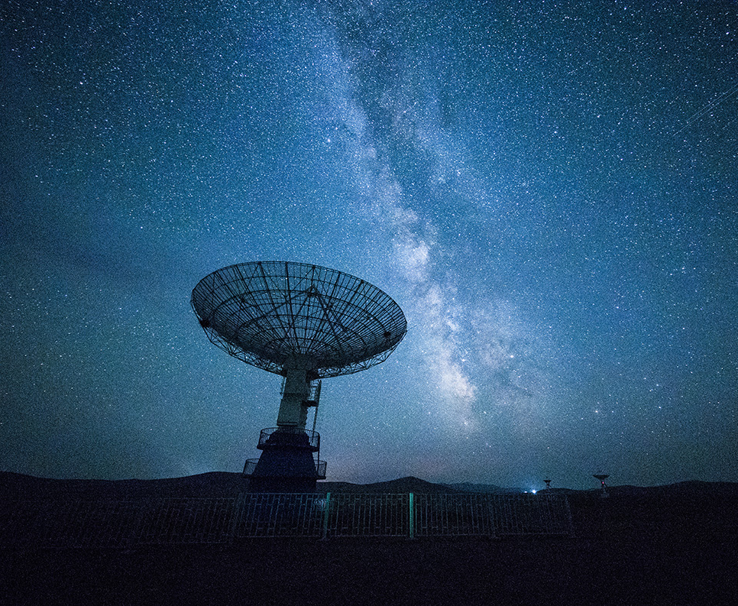
AI in the Real World
Smart Products
Voice Recognition
Virtual Assistants
Self-driving cars

Slide 5
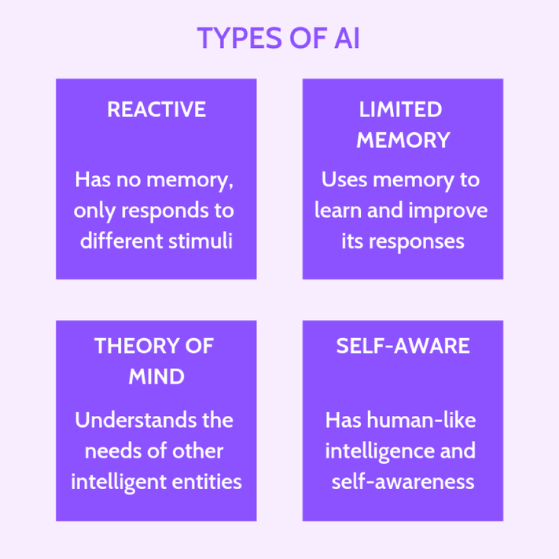

Slide 6
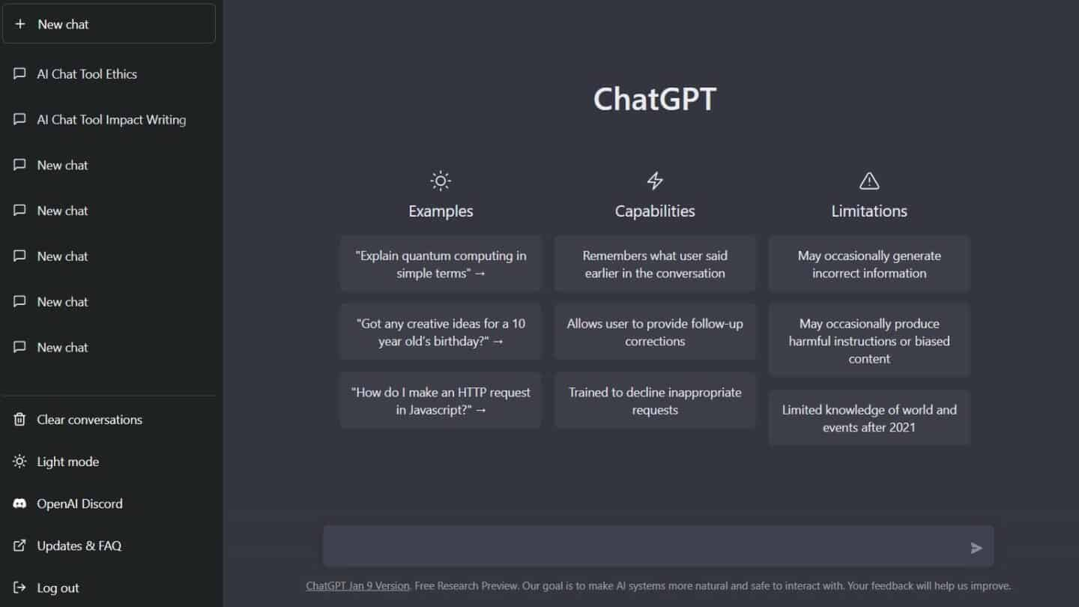

Slide 7
What is chatgpt?
ChatGPT is a large language model developed by OpenAI that uses deep learning techniques to generate human-like responses to user inputs. It is based on the GPT (Generative Pre-trained Transformer) architecture, which has been pre-trained on a vast corpus of text data, allowing it to generate responses to a wide range of queries.
ChatGPT interacts with the world using natural language processing (NLP) techniques, which enable it to understand and respond to human language. It uses machine learning algorithms to analyze the input text, generate a response based on its understanding of the input, and then refine that response based on feedback from the user.

Slide 8
ChatGPT's capabilities include:
Question-answering: ChatGPT can answer a wide range of questions on a variety of topics, based on its understanding of the input text and its pre-existing knowledge.
Language translation: ChatGPT can translate text from one language to another, based on its understanding of the input text and its pre-existing knowledge of the target language.
Chatting: ChatGPT can engage in natural language conversations with users, providing personalized responses to their queries.

Slide 9
Some of the real-world applications of ChatGPT include:
Customer service: ChatGPT can be used to provide automated customer service, answering common questions and providing support to users.
Education: ChatGPT can be used to provide personalized learning experiences for students, answering questions and providing feedback on their work.
Content creation: ChatGPT can be used to generate content for websites and social media, such as product descriptions, blog posts, and social media updates.
Personal assistants: ChatGPT can be used to develop virtual personal assistants that can perform tasks such as scheduling appointments and sending messages.

Slide 10
present and the Future of Ai???
Bias
Lack of transparency
Data privacy
Job displacement
Misuse

Slide 11
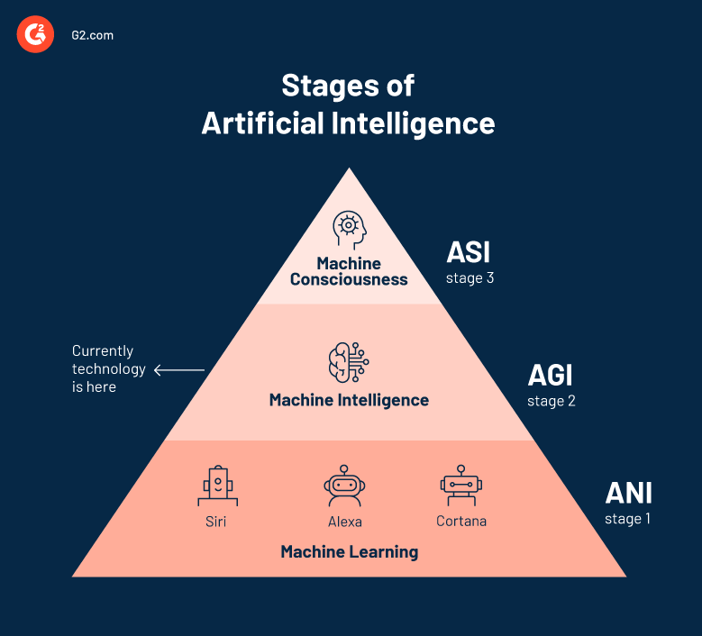

Slide 12
References
https://www.google.com/url?sa=i&url=https%3A%2F%2Fwww.g2.com%2Farticles%2Ftypes-of-artificial-intelligence&psig=AOvVaw0e-Bt4lpBpIi4P9_xfmjld&ust=1677947189071000&source=images&cd=vfe&ved=0CA8QjRxqFwoTCMDU2MOWwP0CFQAAAAAdAAAAABAE
https://www.pewresearch.org/internet/2018/12/10/artificial-intelligence-and-the-future-of-humans/
https://journalofbigdata.springeropen.com/articles/10.1186/s40537-019-0202-7
https://www.wsj.com/articles/chatgpt-ai-chatbot-app-explained-11675865177
https://openai.com/blog/chatgpt/
https://www.cnet.com/tech/computing/why-were-all-obsessed-with-the-mind-blowing-chatgpt-ai-chatbot/

Slide 13

Thank You!
Anand Patel

